Slide 1
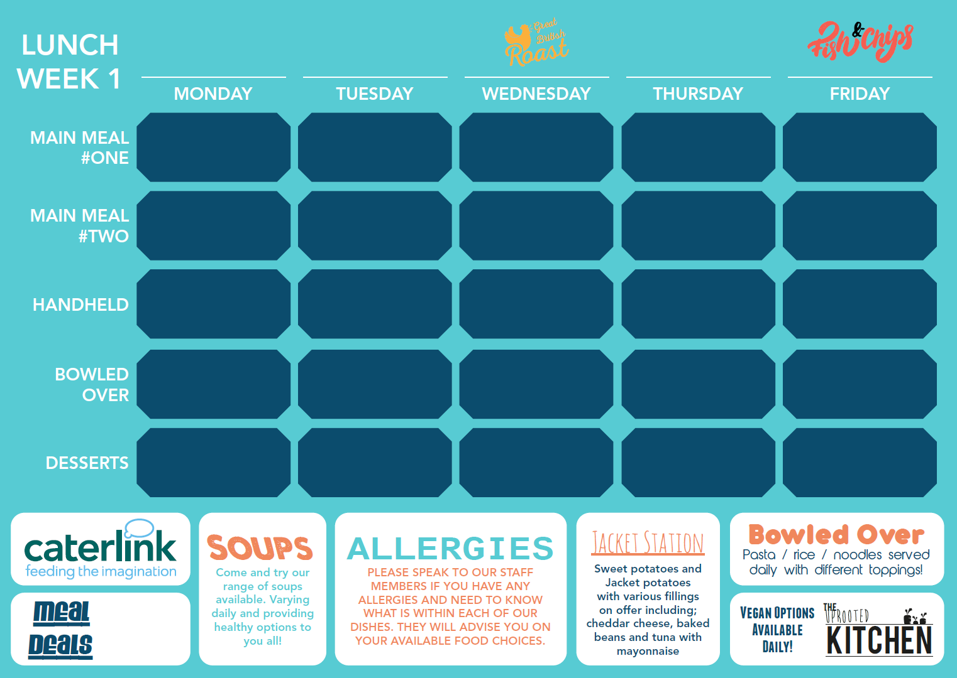
Classic Macaroni Baked in a rich Cheese Sauce and cooked to perfection |  | Jerk Sausages with Mash, Carrots & Gravy |  | Chicken Pie Served with baby potatoes & Broccoli |  | Madras Chicken Curry Served with rice & mango chutney |  | Battered Fillet of Fish served with chips, garden peas or beans & tartare sauce
A choice of meat & veggie toppers, served with house salad & coleslaw |  | Veggy Sausages with Mash, Carrots & gravy |  | Red Pepper & Cheese Frittata Served with baby potatoes & Broccoli |  | Butternut Squash, Chickpea & potato curry Served with rice & mango chutney |  | Chefs Americas Tex Mex Tacos Served with chips & Peas
Cheese & Tomato Panini |  | Chicken Wrap |  | Cheese & Onion Panini |  | Jumbo Hotdog |  | Cheese & Onion Panini
Street Chicken Noodles |  | Herby Tomato Pasta |  | Loaded Wedges |  | Loaded Nachos |  | Tomato Pasta
Lemon Drizzle Sponge |  | Creamy Rice Pudding |  | Apple & Cherry Oaty Crumble |  | Shortbread |  | Chocolate & Banana Sponge
£0.00

Slide 2
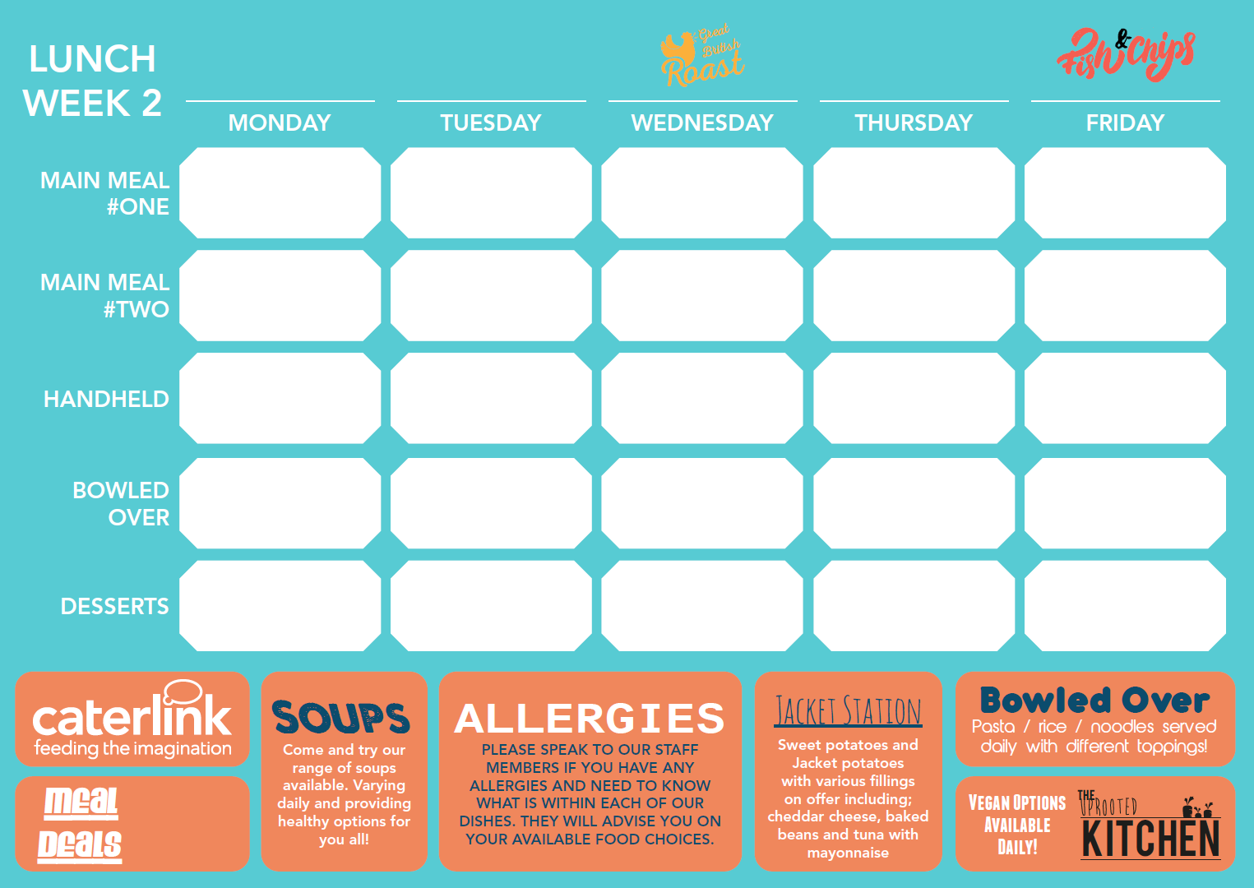
Hearty Meatball Goulash Served with herby rice & sauté green beans |  | Marinated Chicken thigh or drumstick Served with spicy rice & slaw |  | Roasted Chicken Roast Potatoes Seasonal vegetables & Gravy |  | Sweet & Sour Chicken with Vegetables & Egg Noodles |  | Breaded Fish served with chips, garden peas or beans & tartare sauce
Wholewheat Vegetable Pasta Bake Served with sauté green beans |  | Classic Ratatouille Served with spicy rice |  | Smokey Vegetable Enchilada Served With Coleslaw |  | Black Bean Noodles & Stir Fried Vegetables |  | Vegan Slice with Chips & Salad
Authentic Pizza Slice |  | Half Cheese & Tomato Bagel |  | Authentic Pizza Slice |  | Cheese & Tomato Panini |  | Cheese & Tomato Folded Naan
Herby Tomato Pasta |  | Cheesy Pasta |  | Sweet Chilli Noodles |  | Vegetable Chilli & Rice |  | Loaded Nachos
Chocolate & Kidney bean muffin |  | Syrup Sponge |  | Plum Crumble |  | Vanilla Sponge |  | Oatmeal Cookie
£0.00

Slide 3
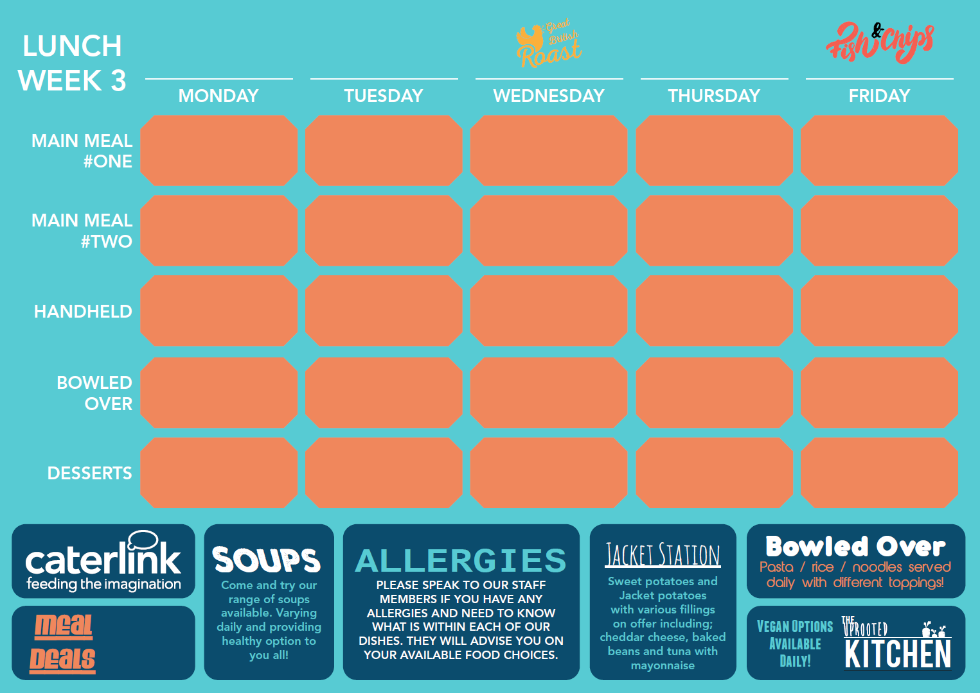
Chicken Jambalaya Served with Latin salad & Nachos |  | Spaghetti Bolognese with Garlic Bread |  | Classic Roast Chicken with Mash, Veg & Gravy |  | Piri Piri Chicken Strips Khobez wrap, Salads & Sauce options. |  | Breaded Fish served with chips, garden peas or beans & tartare sauce
Ramirez Wrap served with latin salad & nachos |  | Plant Based Bolognese with Spaghetti & Garlic bread |  | Macaroni Cheese Bake topped with Crispy Sage Stuffing |  | Falafel & Hummus Khobez wrap, salads & sauce options |  | Cheese & Onion Slice with Chips & Peas
Hot filled Baguette |  | Chicken Burger |  | Tomato & Cheese Panini |  | Authentic Pizza Slice |  | Quorn Wrap
Tomato & Mascarpone Pasta |  | Soy Vegetable Noodles |  | Loaded Nachos |  | Herby Tomato Pasta |  | Loaded Wedges
Cinnamon nachos & chocolate sauce |  | Oaty Flapjack |  | Bread & Butter Pudding |  | Sticky toffee apple crumble |  | Pancake & Cherry sauce
£0.00

