Slide 1
The Palmer Catholic Academy
All About Me
Year 6 Summer Project
Moving from Primary to Secondary School is an exciting, but sometimes scary time! A new building, new rules, new teachers, new routines and new friends are just some of the changes you will experience but this booklet will help you get used to some of the routines and features of your new school!

Slide 2
Draw a self portrait here.
Name:
Birthday:
My Primary School:
Eye Colour:
Hair Colour:
Height:
Favourite Colour
Favourite Animal
If I could have a superpower, I’d….
Favourite School Subject
Best place I’ve ever been to…
Dream country to visit…
If I could travel back in time, I’d go to…
My dream job is…

Slide 3
Life is a journey! Think back through primary school and write down your favourite memories or events that have shaped you to become the amazing person you are!

Slide 4
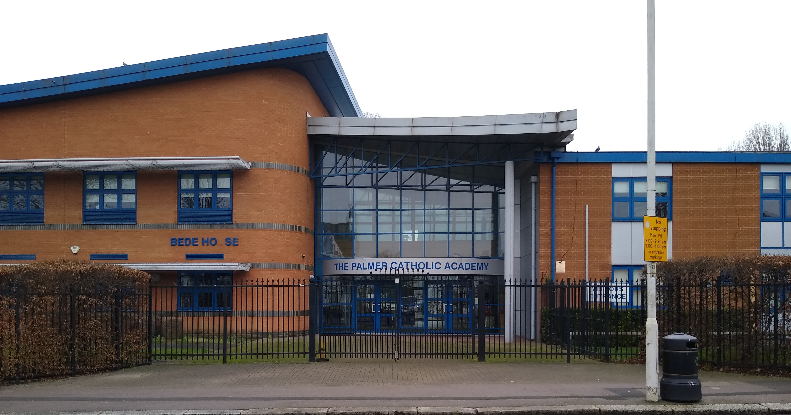
Full Name of the School
School Address
School Telephone Number
Name of the Head Teacher
School Starts at
School Finishes at
I will get to school by
How long will it take you to get to school?
What time will you have to leave home?
Add 10 words around the image below to describe your new school .

Slide 5
List 4 things you are most excited about moving to The Palmer Catholic Academy
List 4 things you are a little worried or nervous about
List 4 things you would like to know about The Palmer Catholic Academy
List 4 things that will help you when moving to The Palmer Catholic Academy
List 3 differences between your primary school and The Palmer Catholic Academy

Slide 6
Find the subjects below in the Word search – they are vertical, horizontal and diagonal!
M | A | F | S | E | H | M | G | E | O | H | I | M | J | E | E | A
F | M | A | M | W | S | L | U | S | M | I | S | E | T | T | I | S
R | U | D | A | N | C | E | Z | S | A | C | P | N | U | H | A | I
A | F | G | T | R | D | P | W | R | I | I | A | G | T | I | N | U
H | S | R | H | P | G | R | T | E | N | C | I | T | O | C | A | O
J | T | A | S | L | U | B | N | Y | R | A | N | E | R | S | S | L
T | U | B | J | E | I | C | Q | L | E | R | M | X | T | A | S | S
E | E | A | U | H | E | M | U | A | H | S | U | D | I | N | E | P
N | F | X | L | G | E | O | G | R | A | P | H | Y | M | D | M | A
G | I | M | T | V | M | A | I | T | Y | E | O | A | E | M | B | N
L | O | A | I | I | O | T | O | H | R | T | T | S | C | O | L | I
I | P | T | E | E | L | G | R | D | U | O | E | R | A | R | Y | S
S | P | U | F | O | S | E | E | K | R | M | P | T | T | A | E | H
H | I | S | T | O | R | Y | S | C | S | A | S | M | E | L | R | A
E | N | J | V | E | P | I | F | J | N | O | M | U | R | S | B | K
J | K | C | A | T | E | R | I | N | G | C | N | A | R | P | U | M
Y | Z | X | T | L | S | V | Z | C | O | M | P | U | T | I | N | G
Maths
English
Science
Geography
History
Art
Music
PE
Drama
Catering
Computing
Spanish
Assembly
Tutor Time

Slide 7
Match up the subject to the correct icon
Maths
English
Science
Geography
History
Art
Music
PE
Drama
Catering
Computing
PSHE
Spanish
Form Time

Slide 8
At secondary school, you will be moving around to different classrooms for different lessons. This means that you need to bring all the equipment you will require with you for the day.
Below are some items you will need to bring – can you identify them and add anything else?

Slide 9
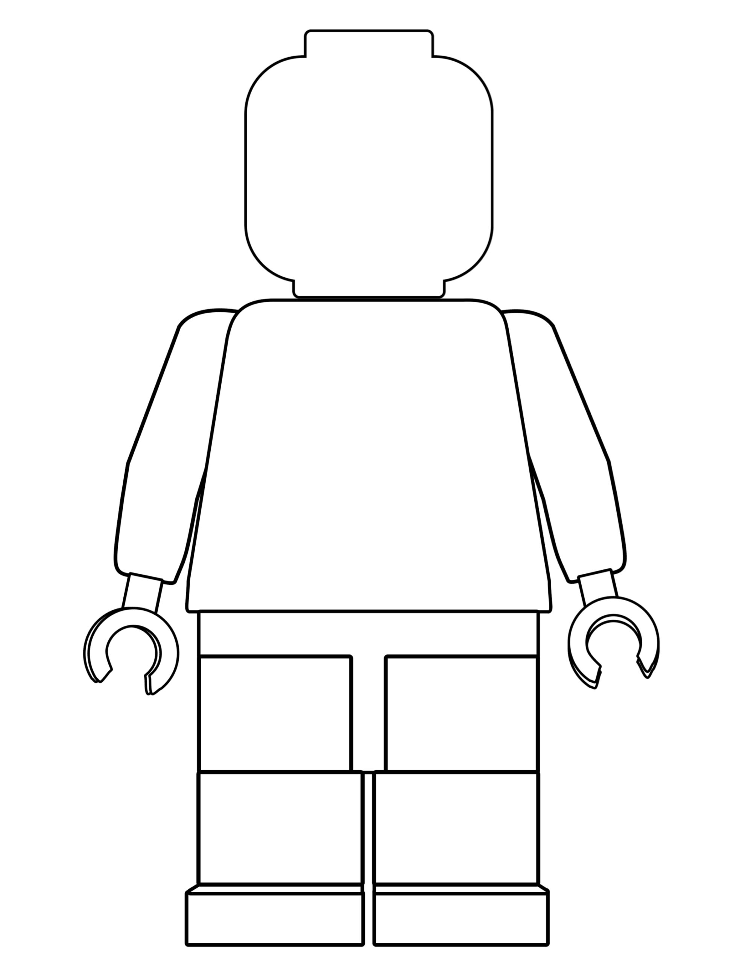
One of the different things about moving to secondary school is the change in what you will wear. At The Palmer Catholic Academy we pride ourselves in looking smart and professional at all times. Use the school website or the information booklet to draw and label the school uniform you will wear onto the Lego figure
Why is wearing the correct school uniform important?
…………………………………………………………………………………………………………………………………………………………………………………………………………………………………………………………………………………………………………………………………………………………………………………………………………………………………………

Slide 10
Getting to The Palmer Catholic Academy safely is just as important as being there. In the box below, draw the route you are going to take to school (whether that’s walking, cycling, driving or by bus). Identify spots where there could be hazards (e.g. busy roads) and explain how you will manage this safely!

Slide 11
When you go to Secondary School, you will learn a huge number of new skills, and improve skills you have practiced in Primary School. In the goal below, use the list to write in 10 new skills or things you’d like to build on in your years at Secondary School.
Be in a school play or production | Speak another language | Represent your school in a national competition
Learn to play a musical instrument | Volunteer in the local community | Travel to another country
Play for a school team | Learn how to survive in the wild | Take care of the school garden
Learn how to manage money | Taste food from another country | Walk the school dog
Cook a new meal from scratch | Read new books | Take part in a fancy dress day
Create a piece of art | Raise money for charity | Become Head Boy or Girl
Learn how to read a map | Join an after school club | Learn to dance
Use computers to create your own website | Learn First Aid | Improve your singing
Make new friends from other schools | Work as part of a team | Try camping

Slide 12
After secondary school, you can move onto college or an apprenticeship and then to University or into a job! It’s normal not to know what you want to do yet but this is a chance for you to have a think about your dream jobs!
Icons to represent that job:
Icons to represent that job:
Icons to represent that job:

