Slide 1
Have you heard of this show?
Why/how did they get their powers?

Slide 2
September:
Sickle cell awareness month
https://youtu.be/qK5H9fPkltc?si=ipRAZkcmwDER-x2l

Slide 3
Importance of donating blood
Alleviates symptoms and is used as a treatment for the conditions associated with Sickle cell anemia.
There is a significant shortage in blood donors of ethnic minorities, which is crucial for Sickle cell patients or those with other blood disorders as blood matched to your own allows you to get the best treatment.
More often than you realise, a lot of people of black heritage often have low iron levels, which means you are not able to donate.Check your iron levels!!

Slide 5
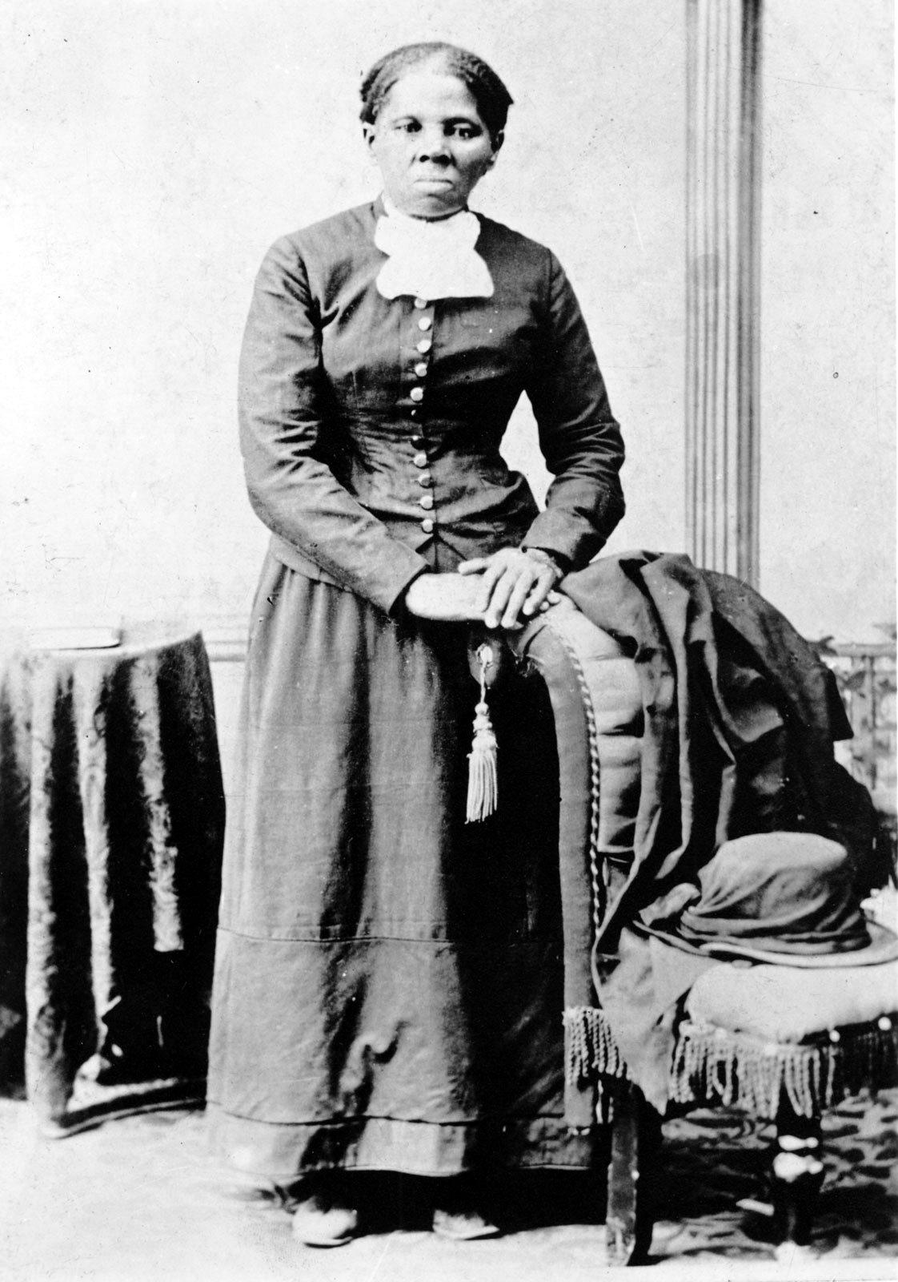
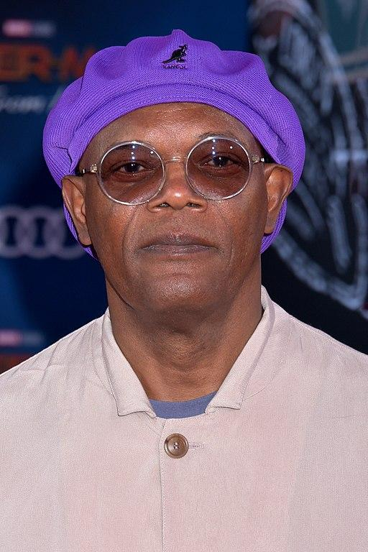
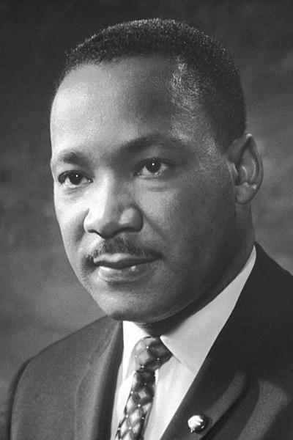
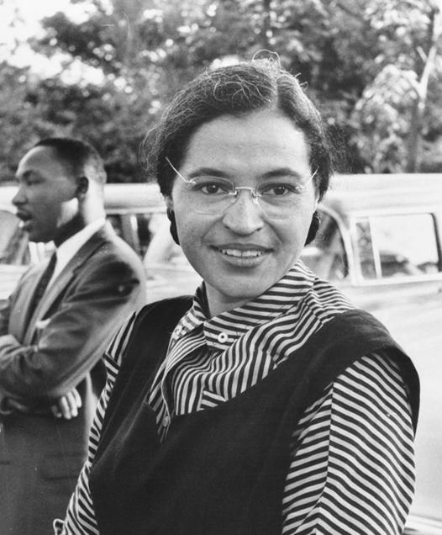
What do you think that these People have in common?

Slide 6
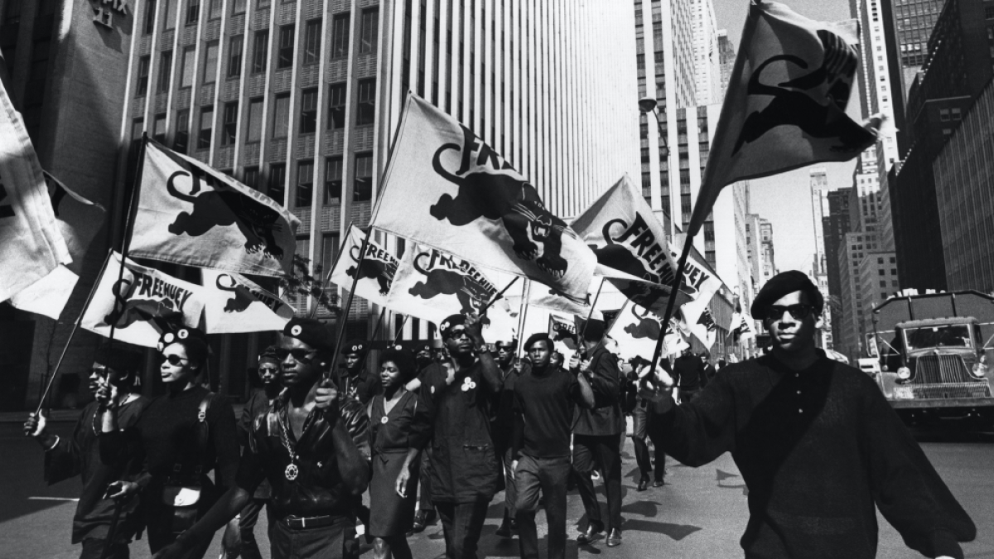
Answer: They all made a difference in their own industries?
Each of the five black figures have made significant impacts in their vocations. They helped shape the world and spread diversity amongst entertainment and society as we know it !!
They were able to achieve this through hard work, resilience and dedication. By celebrating Black History Month as a community, we are commemorating and acknowledging them for all their success.

Slide 7
Why are we telling you this?
On the 24th of October, the student leadership team has organised an after school event which presents black excellence within modern society!!!
This includes showcasing:
Recitals
Poems
Drama performances
Singing
Art (sculptures, paintings etc…)
Dance
Instrument performances
This is not solely targeted to the black community, all cultures are welcome, this month is an opportunity for all pupils to show appreciation for black figures who inspires us. This can vary from:
Friends/ families
Teachers
Idols (Musicians, Athletes, Artists etc)
Emails:
Nayari.SilvaNeto18@tpc.academy
Dorina.Veste18@tpc.academy

